Slide 1
In Season Nitrogen Calculator
Developed by David Cox

Slide 2
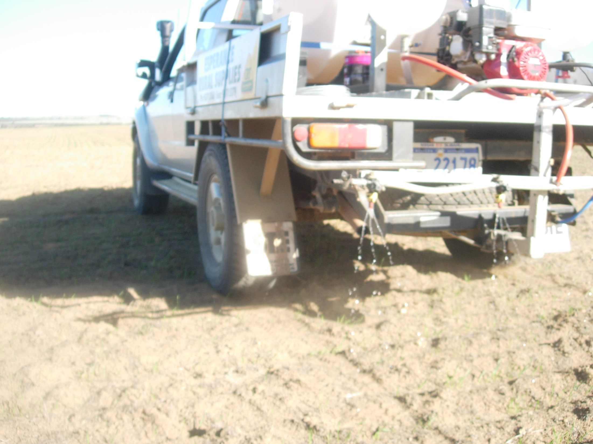

Slide 3
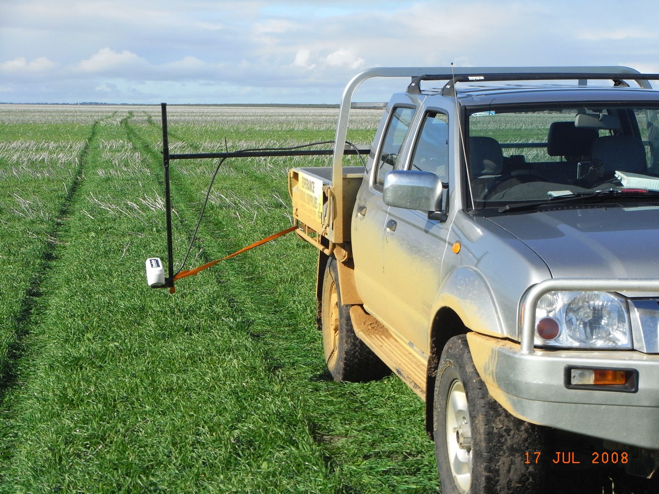

Slide 4
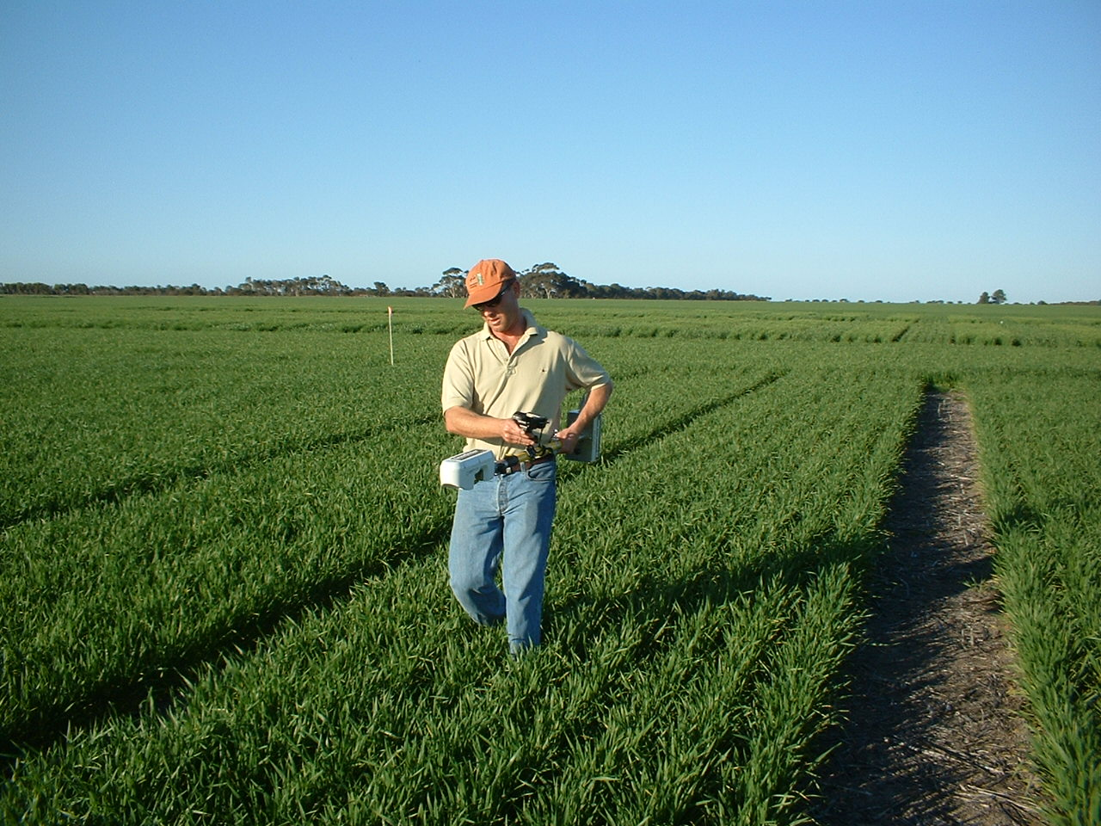

Slide 5
